Slide 1


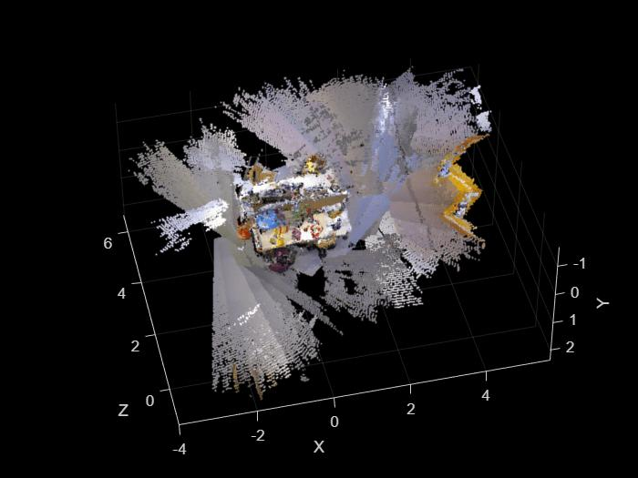
College of Engineering & Physics
Electrical Engineering Department
Instructor: Dr. Ali AlBeladi
From NeRF to NeRF-SLAM: Current Progress
Course Project Progress Presentation — EE656: Robotics & Control
Muhammed Elyamani
G202427600
April 2026

Slide 2
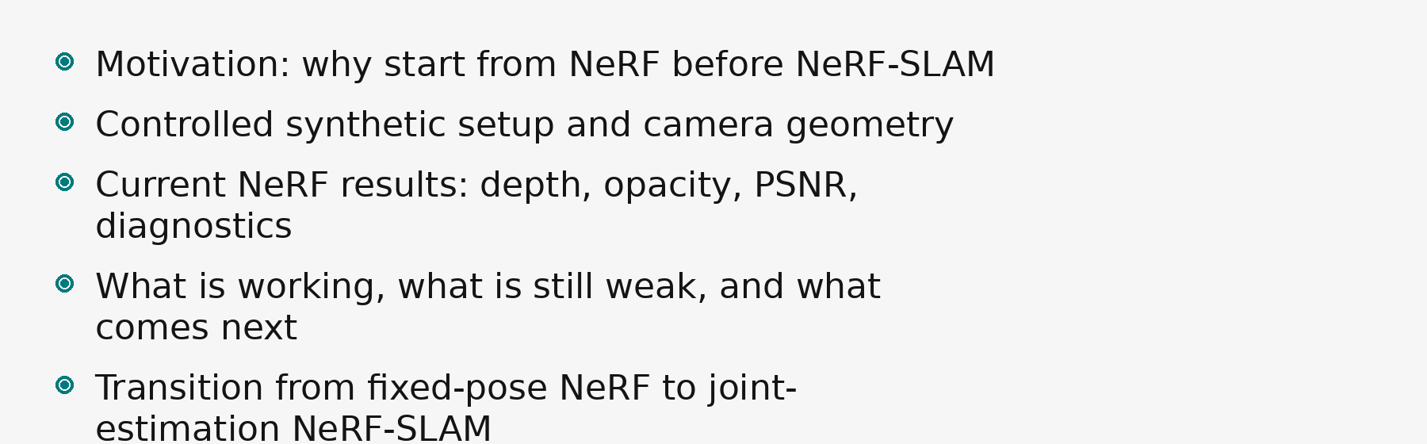
Talk Roadmap
si poles
1

Slide 3
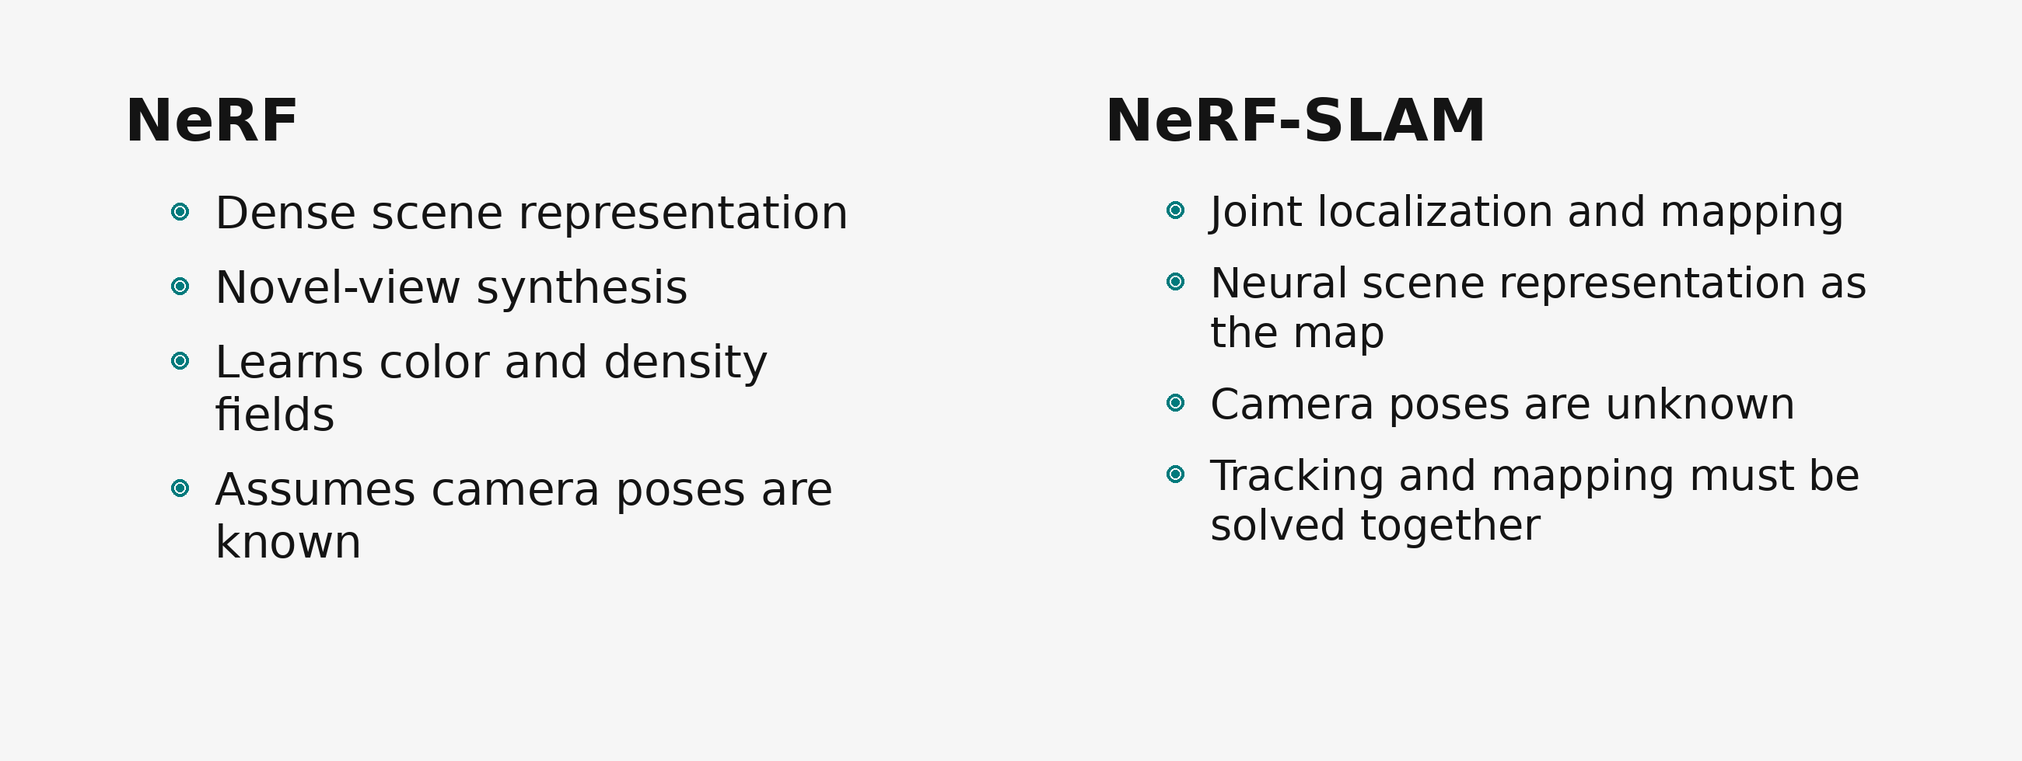
Why NeRF Before NeRF-SLAM?
si poles
2

Slide 4
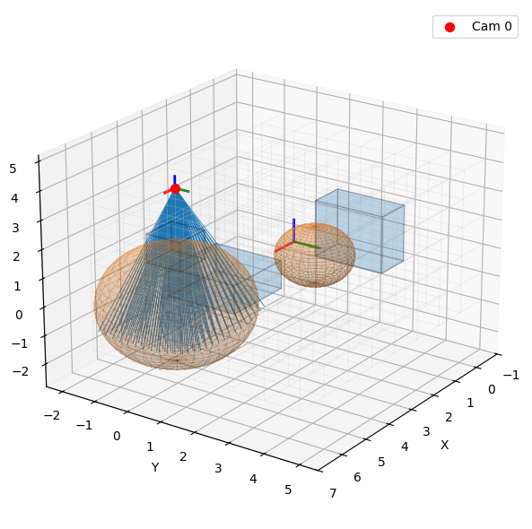
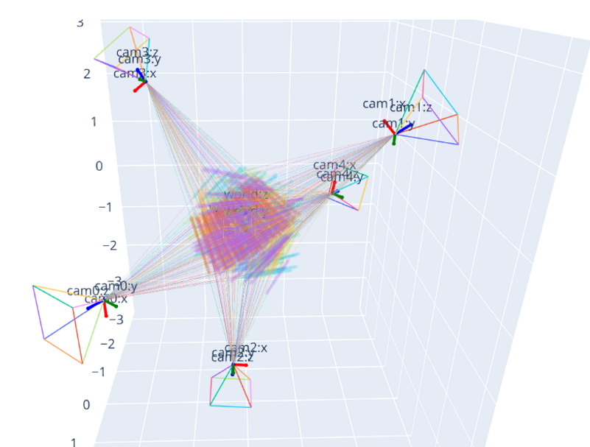
Synthetic Scene and Camera Setup
si poles
3

Slide 5
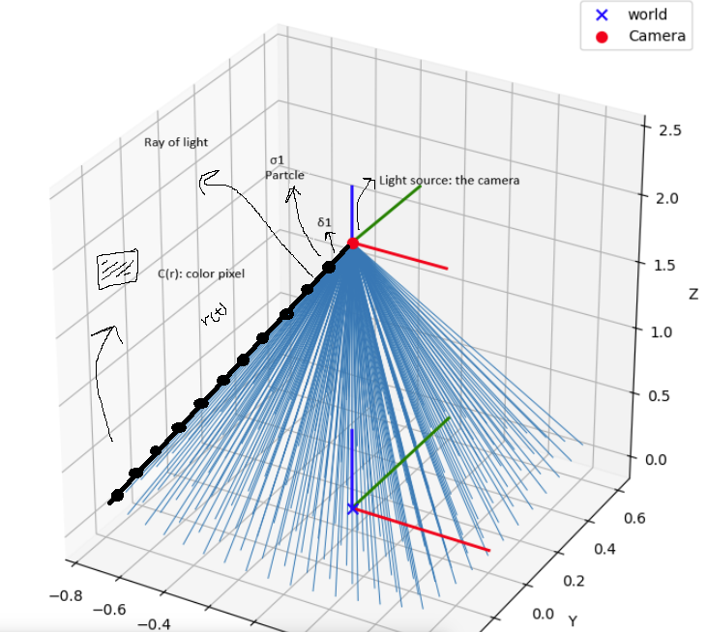
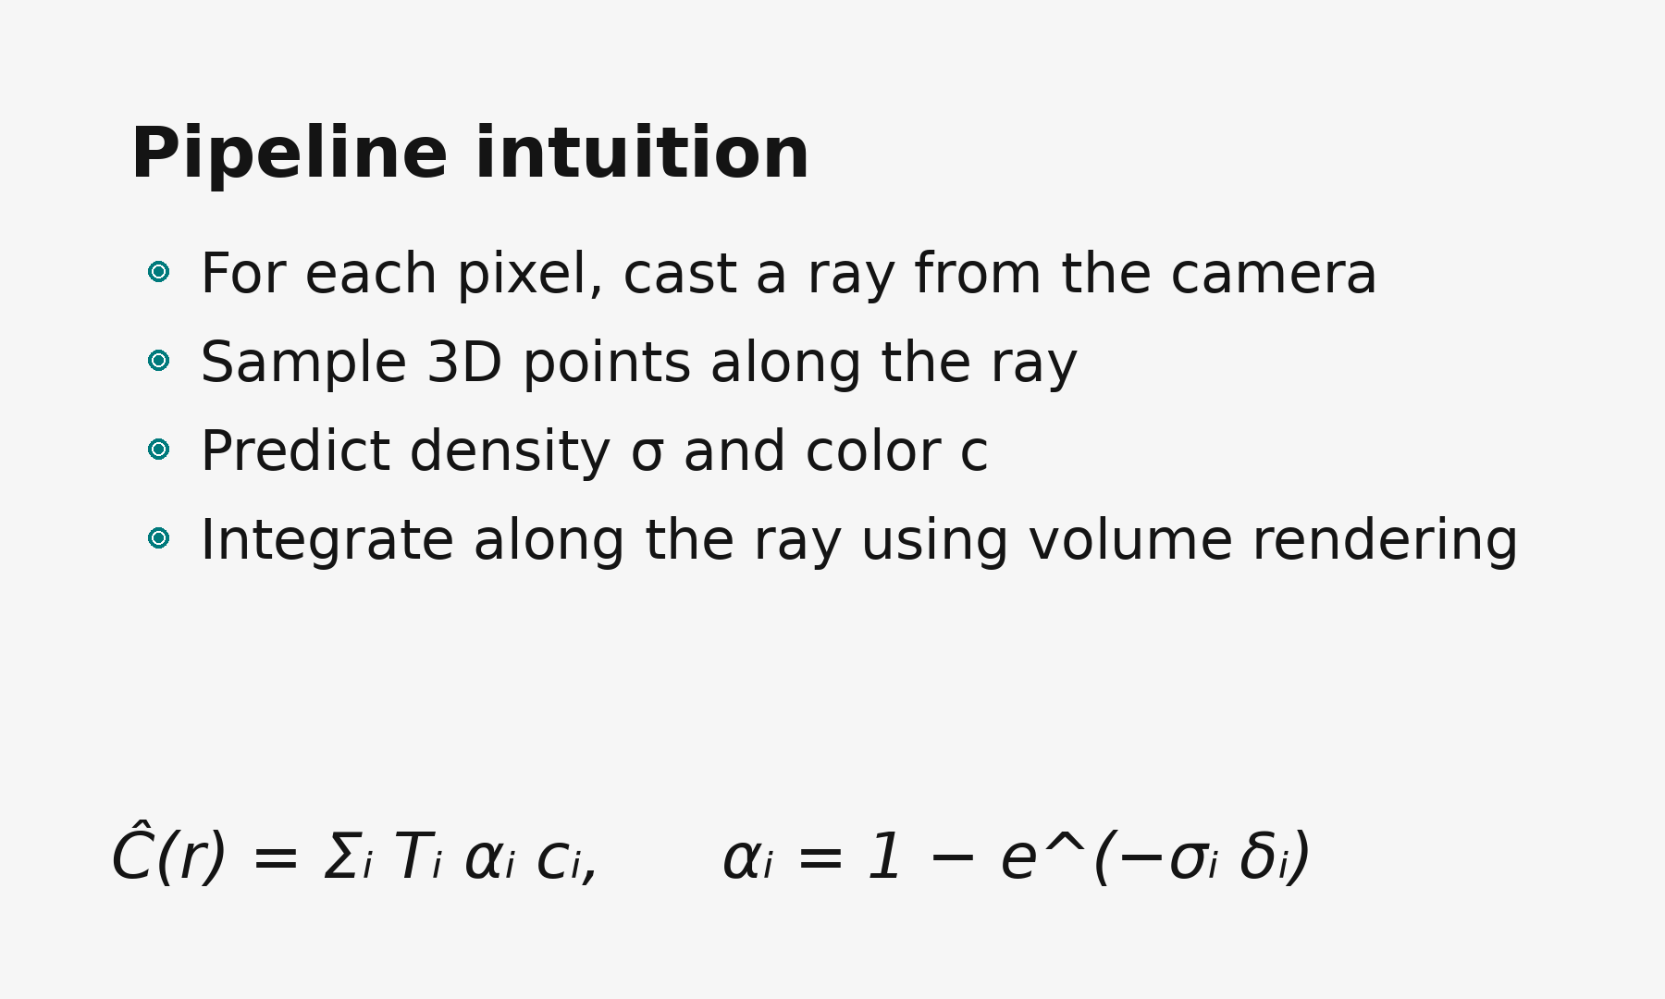
NeRF Ray Rendering Intuition
4

Slide 6
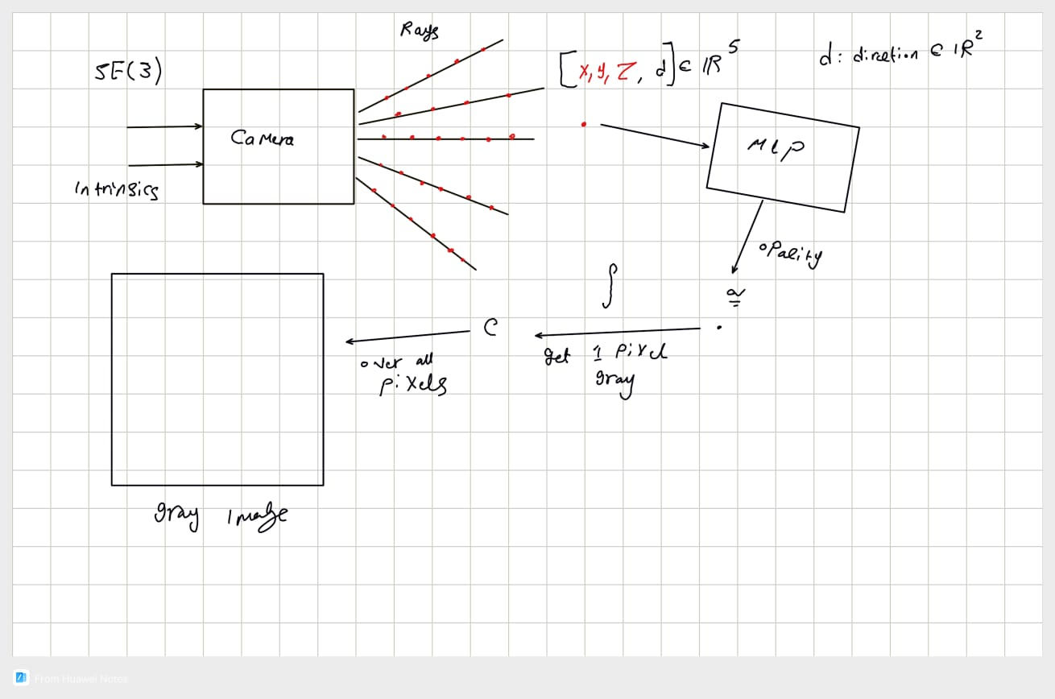
NeRF pipline
si poles
5

Slide 7
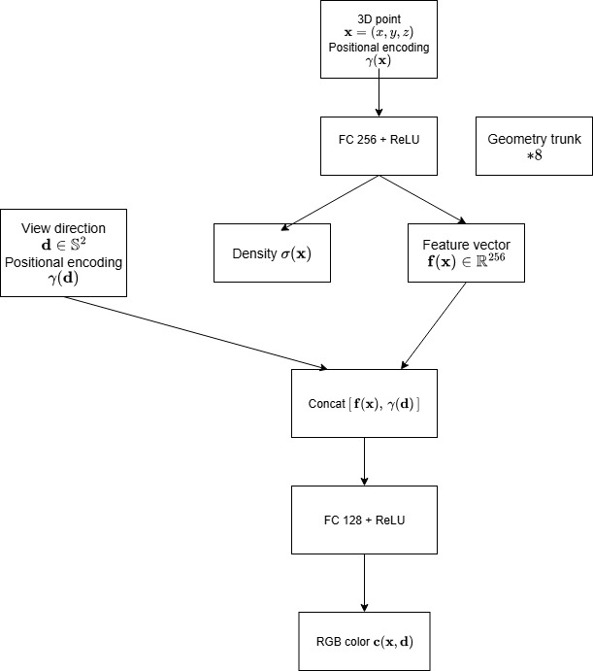
NeRF Network Architecture
si poles
5

Slide 8
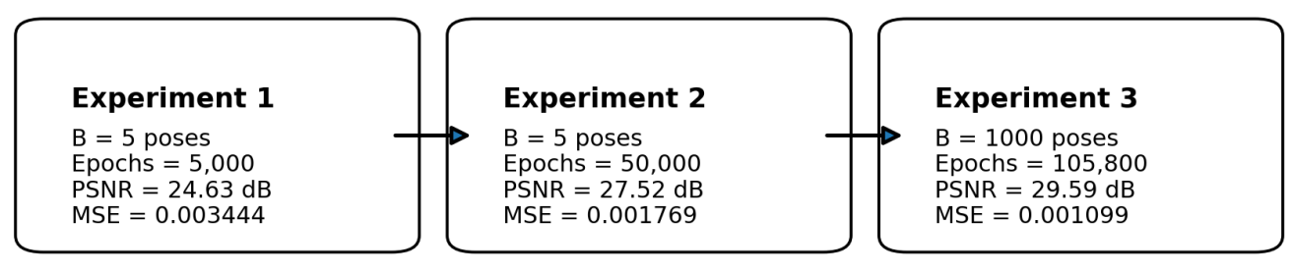
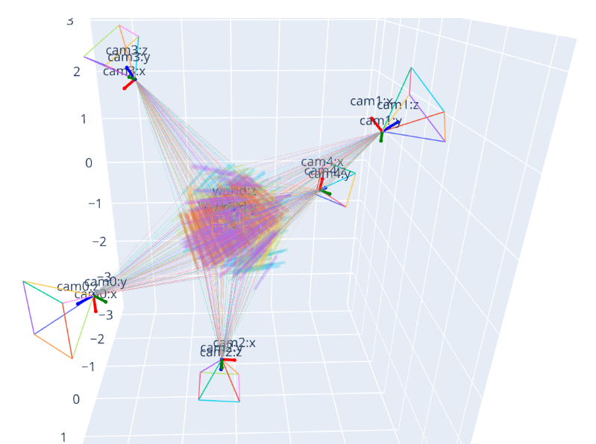
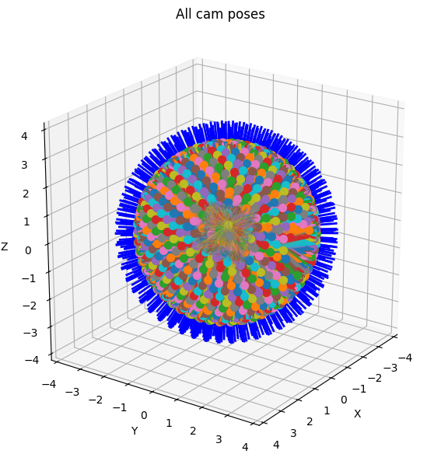
Experimental Variants
si poles
Exp. 1 render time: CPU 4.78 s, CUDA 0.89 s
Exp. 3 render time: CPU 4.78 s
B = 1000 poses
B = 5 poses
6

Slide 9
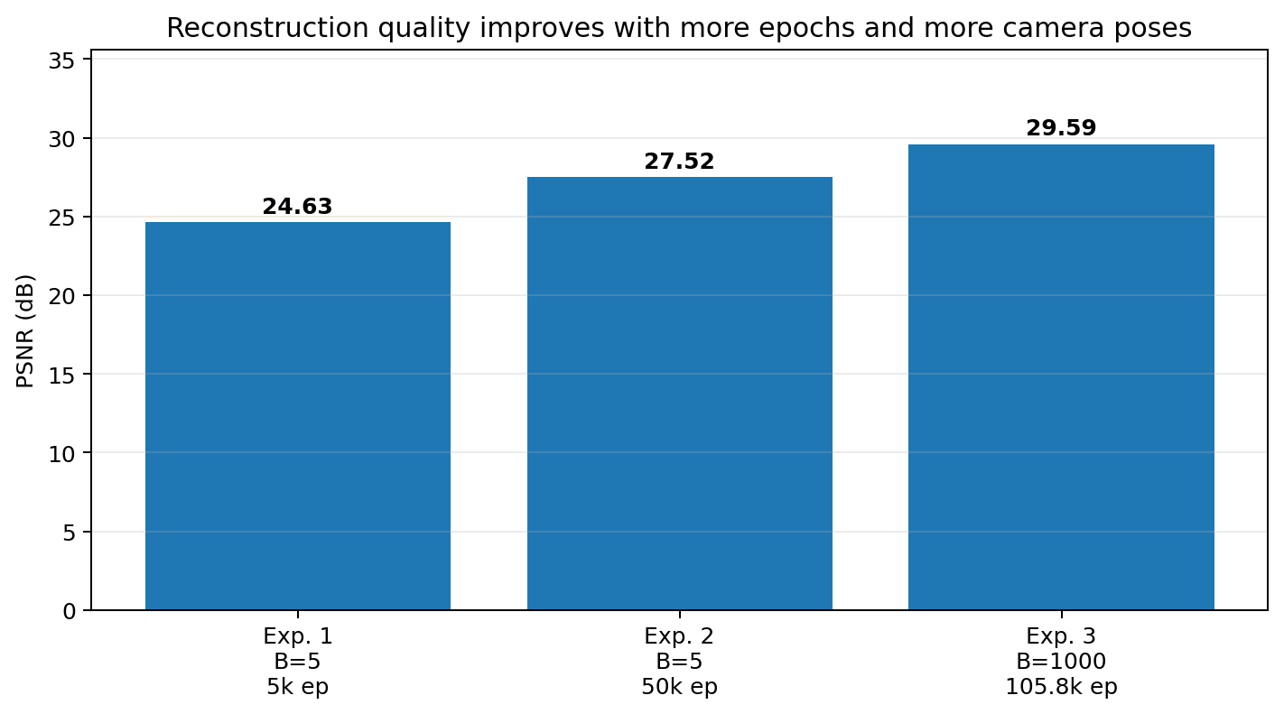
Experimental Variants
si poles
7

Slide 10
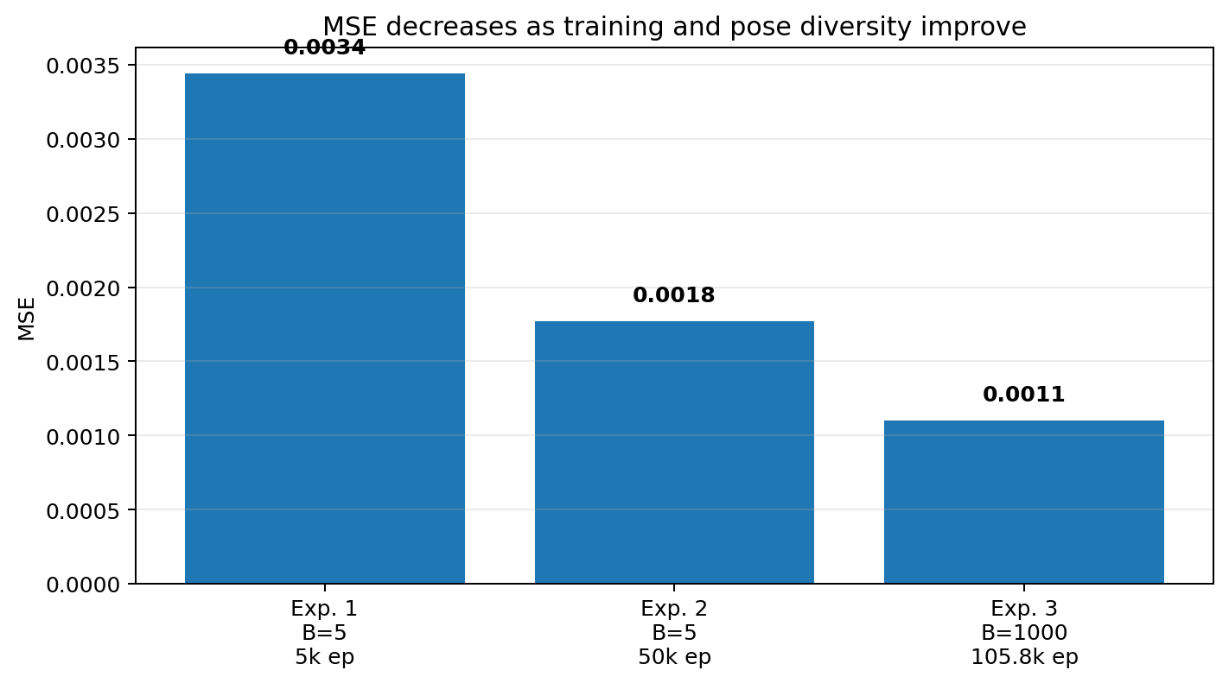
Experimental Variants
si poles
8

Slide 11
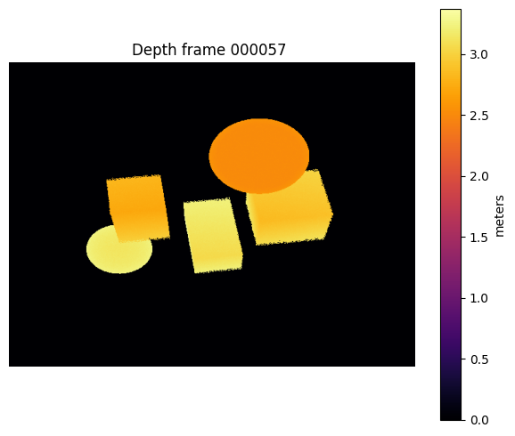
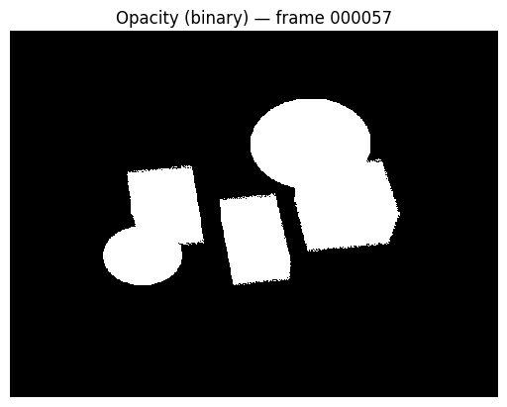
Qualitative Results: Depth and Opacity
esi poles
9

Slide 12
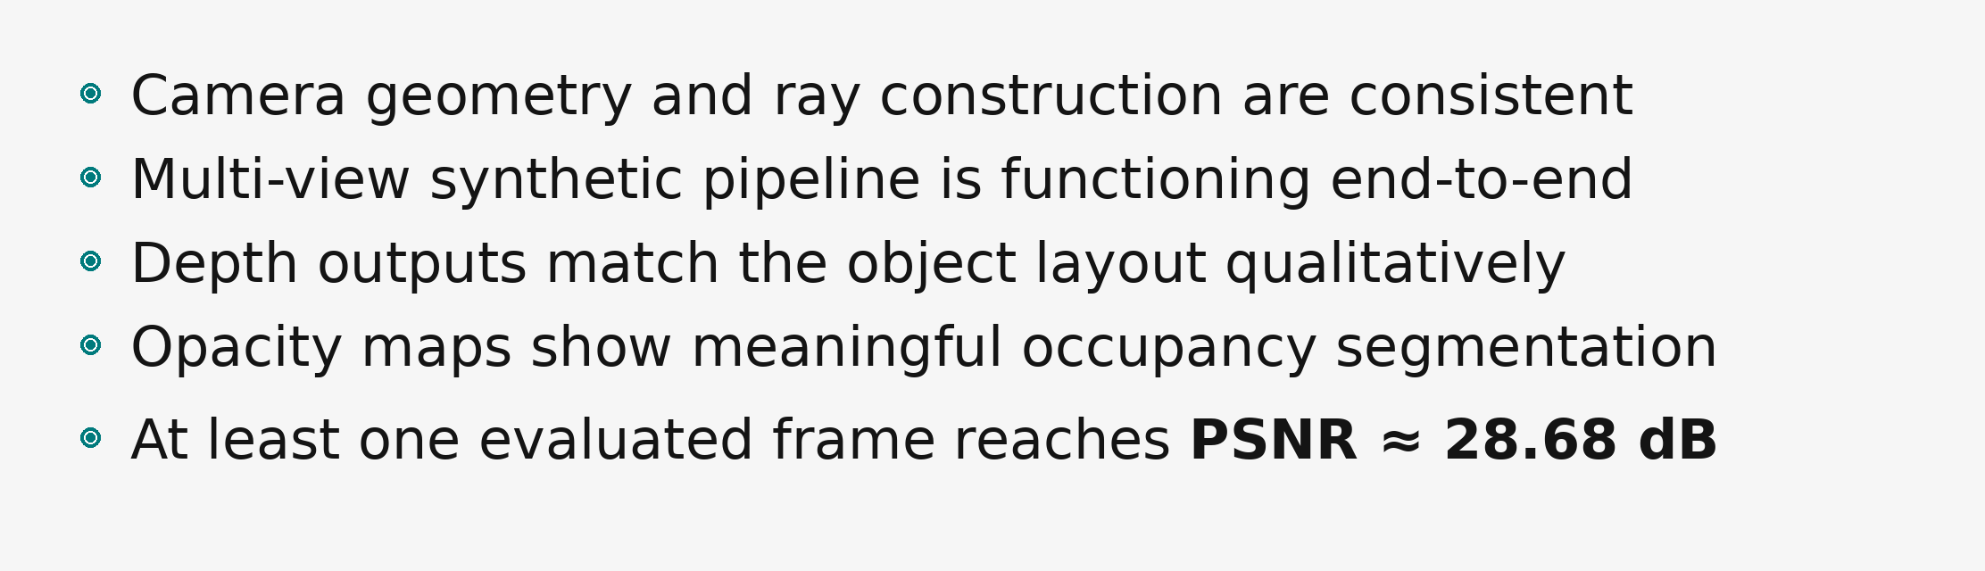
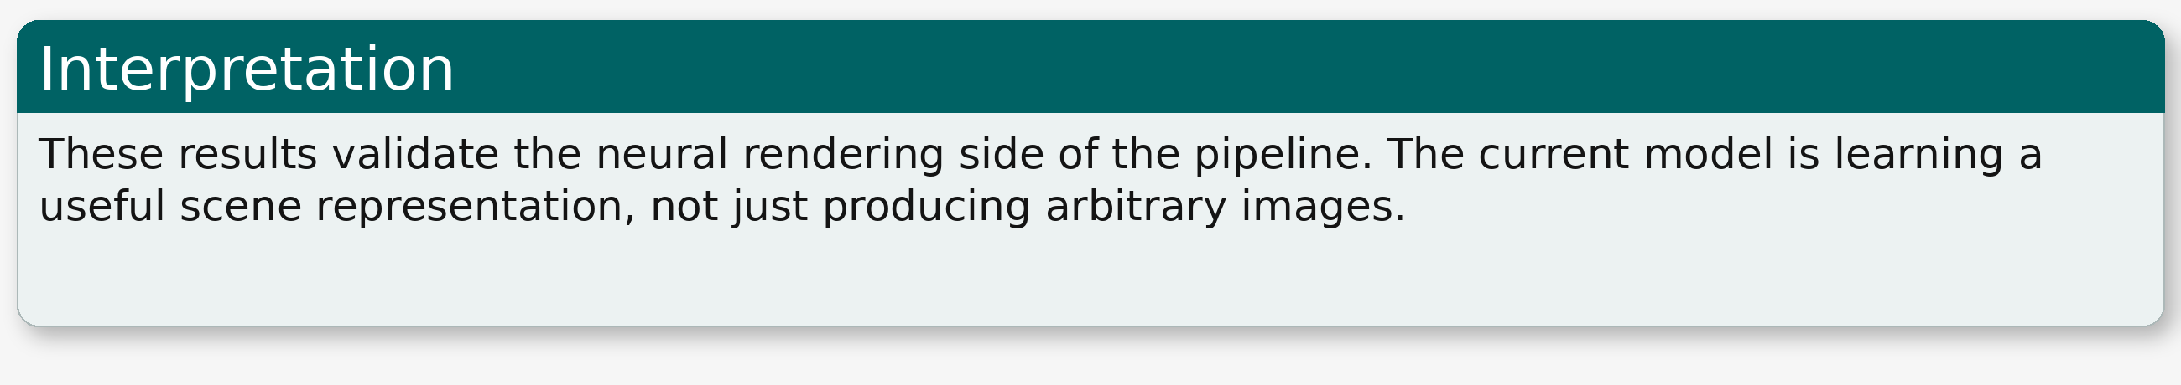

What Is Already Working?
esi poles
10

Slide 13
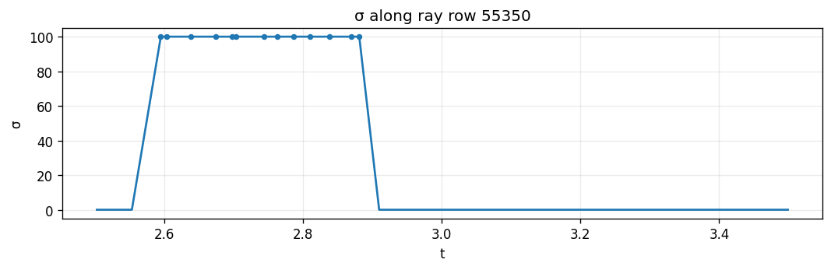
Diagnostics and Debugging
esi poles
Sigma along a selected ray
11

Slide 14
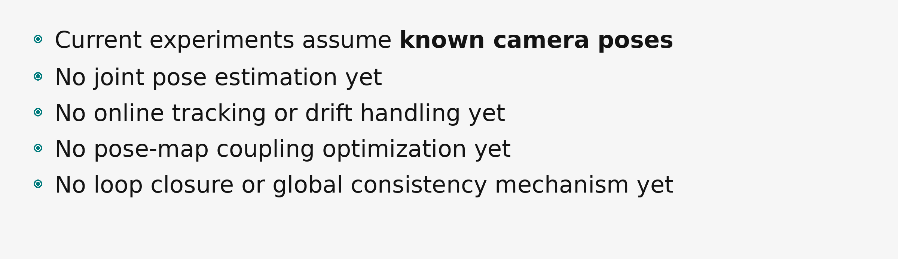
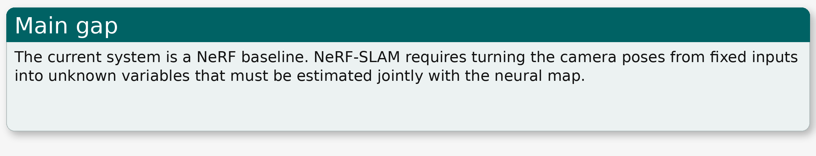
What Is Still Missing for NeRF-SLAM?
si poles
12

Slide 15
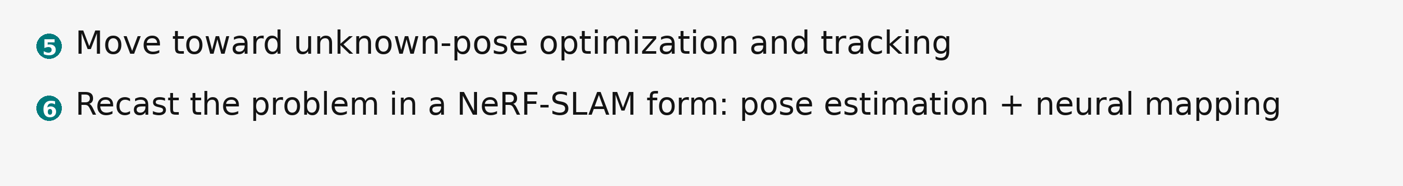
Next steps
si poles
13

Slide 16
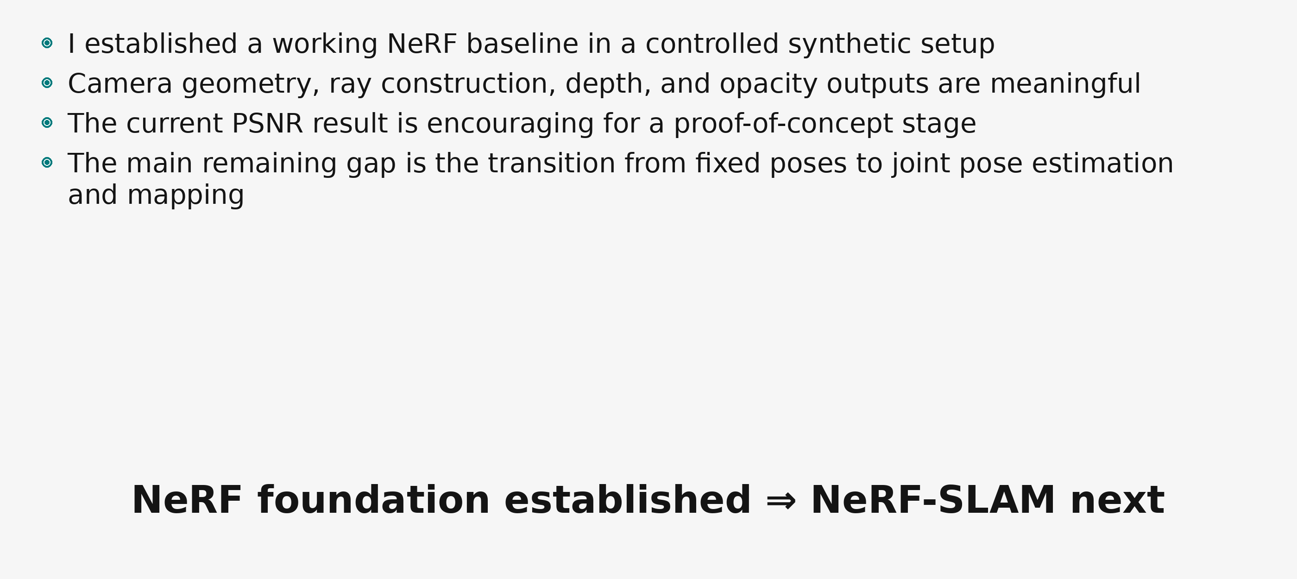
Conclusion
si poles
14

Slide 17
Thank You
I appreciate your time and attention.
I'm ready to take your questions.

